Slide 1
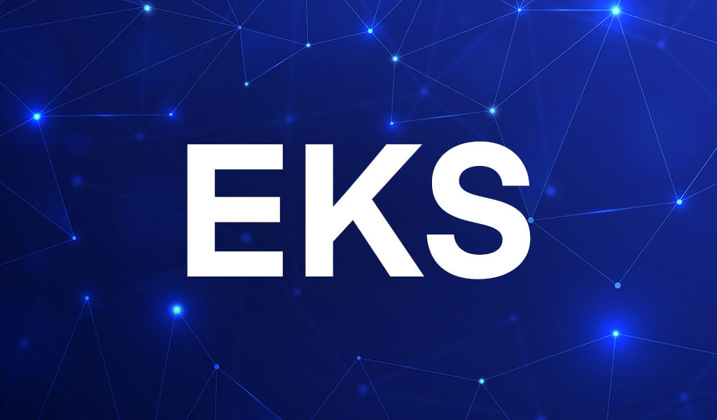

Elastic Kubernetes Service
Presented by: Bibek Mishra

Slide 2
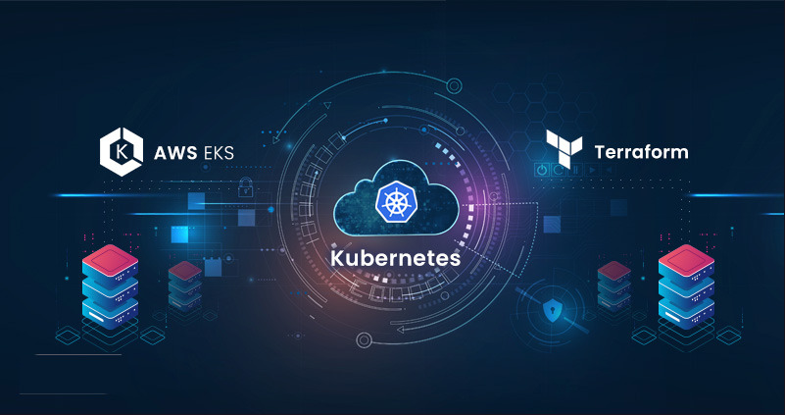

Slide 3
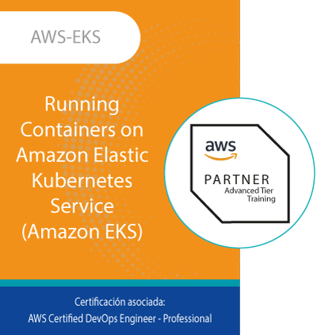

Definition of EKS
manage containerized applications
handles the details of
scaling, availability, and security
without worrying about underlying infrastructure

Slide 4
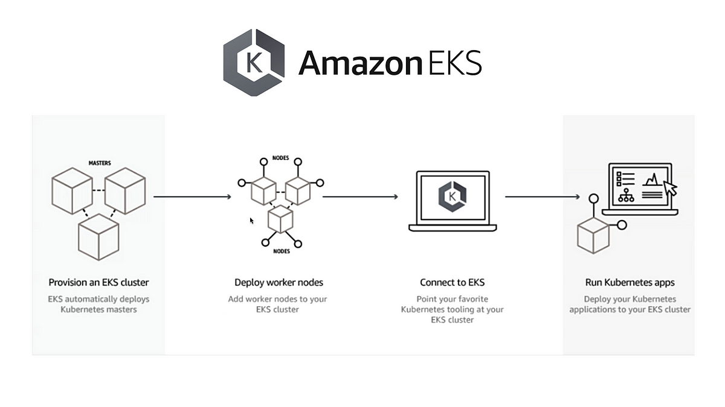

Slide 5
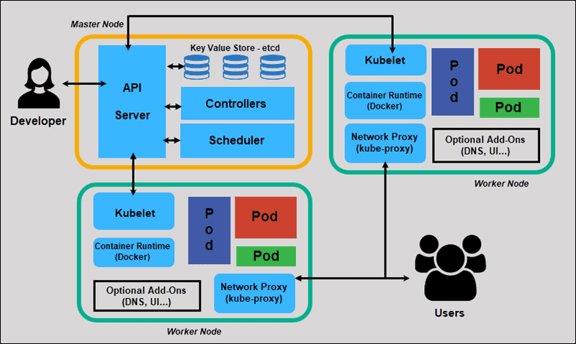

Slide 6

Level 1 Completed
You have successfully deployed and connected to EKS Cluster

Slide 7


Instead Let’s go to meet a friend ;)
Y
o
u
Lets take a break !

Slide 8
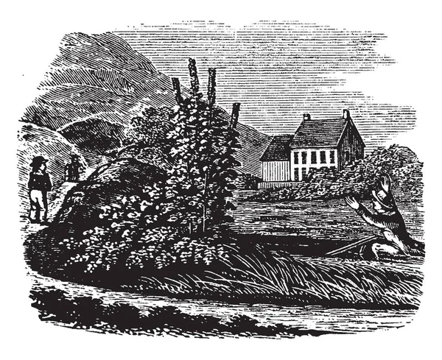



Slide 9

Y
o
u
Y
o
u
r
F
r
i
e
n
d
But what my friend?
let's explore together :)
Customizability is my next goal.
It was fun completing the Level 1 :)
That’s soooo cool.
That’s okay but….
I want to focus on securing EKS from the beginning
What have you planned next?

Slide 10
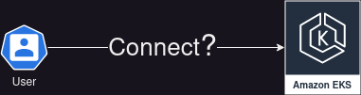
How do you connect to EKS cluster?

Slide 11
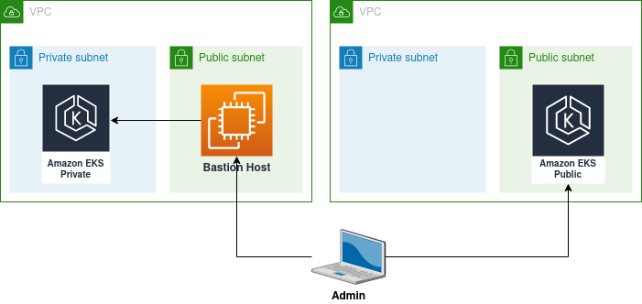
Securely connect to EKS Cluster
EKS Endpoints
can be either public or private

Slide 12
Terraform
resource "aws_eks_cluster" "example" {
name = "example-cluster"
role_arn = aws_iam_role.example.arn
version = "1.21"
# ... other cluster configuration ...
vpc_config {
# ... VPC configuration ...
}
endpoint_public_access = true # Set to 'false' for private endpoint access
endpoint_private_access = false # Set to 'true' for private endpoint access
}

Slide 13
That’s a good question :) Let’s jump to next slide….. :)
Y
o
u
Y
o
u
r
F
r
i
e
n
d
For what kind of project should I use EKS?
Hei, I have a question for you?

Slide 14
When project has:
Advanced Features(limited)
no requirement for auto-scaling, load-balancing, or rolling updates
Small-scale Applications
doesn't have many components or services
Tight Budgets
We don’t use EKS

Slide 15
When project has:
Large, Complex Workloads
automated scaling, load balancing, rolling updates..
Availability and Reliability
for running containerized workloads
Long-Term Projects
EKS cost spread out over a longer time
We use EKS

Slide 16

That was awesome !!!
Y
o
u
Y
o
u
r
F
r
i
e
n
d

Slide 17

Y
o
u
Y
o
u
r
F
r
i
e
n
d
Do you know I was researching on Calico?

Slide 18

Y
o
u
Y
o
u
r
F
r
i
e
n
d
Yeah, it is Container Network Interface (CNI) plugin for Kubernetes, provides enhanced network security features.

Slide 19
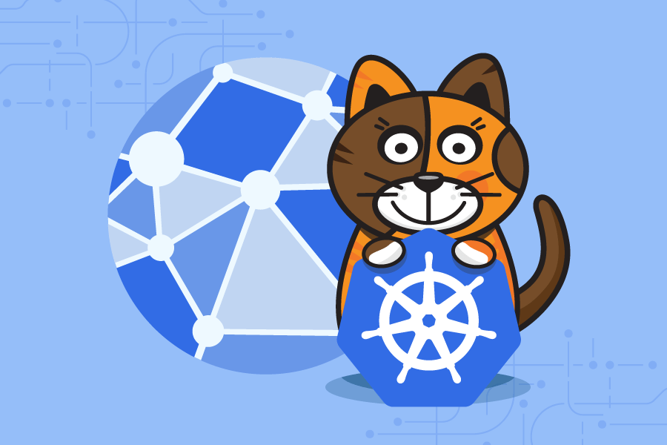
Calico provides a range of networking features network policy enforcement, load balancing, and IP address management.

Slide 20
Y
o
u
Y
o
u
r
F
r
i
e
n
d
Do you know similar tools like Calico?
I have heard about WaveNet Flannel

Slide 21
Have you heard about Cilium?
Y
o
u
Y
o
u
r
F
r
i
e
n
d
What is eBPF?
Is it really easy to configure it?

Slide 22

Y
o
u
Y
o
u
r
F
r
i
e
n
d
Yeah, I have configured Cilium in my EKS Cluster.
Here I will show you.

Slide 23
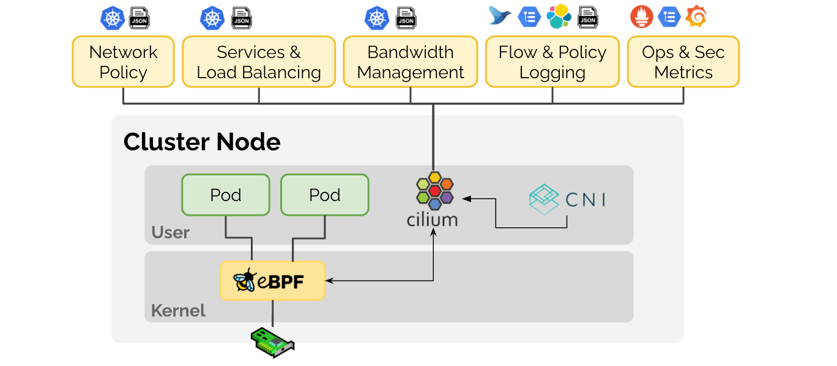
Extended Berkeley Packet Filter

Slide 24
Lightning-fast Networking
Top-Notch Security
Transparent Encryption
Network visibility
Easy Configuration
Key Benefits of Cilium for Kubernetes

Slide 25
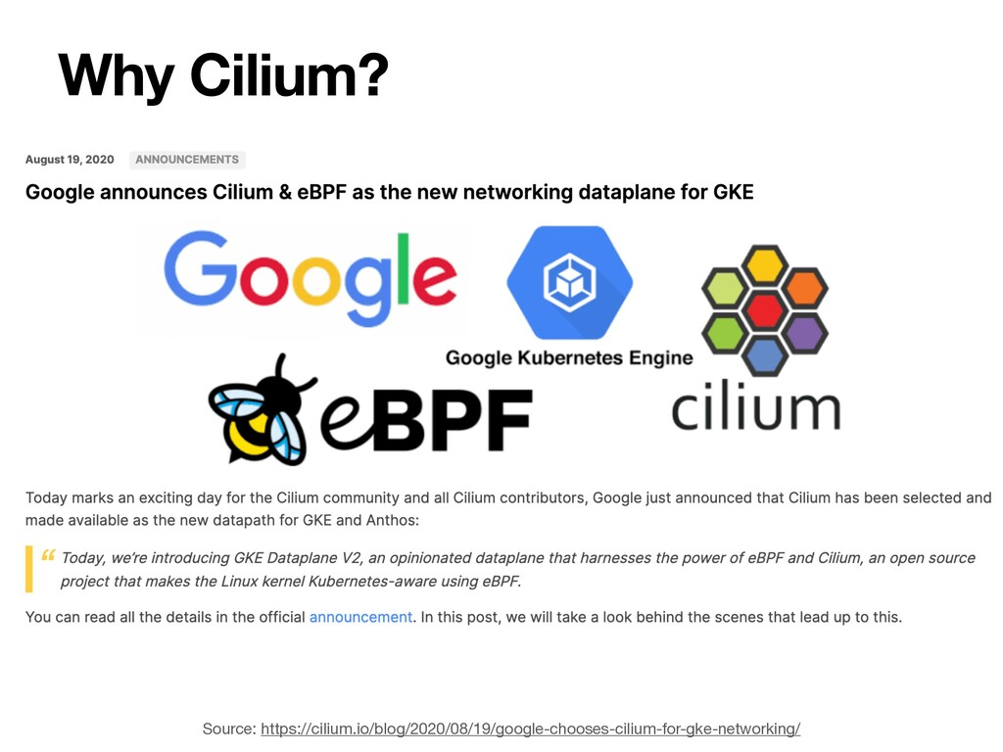

Slide 26

Y
o
u
Y
o
u
r
F
r
i
e
n
d
You really describe things so easily bro.

Slide 27

Y
o
u
Y
o
u
r
F
r
i
e
n
d
Can you show me the configuration part of Cilium?

Slide 28
Y
o
u
Y
o
u
r
F
r
i
e
n
d
I have prepared a NoteBook for Cilium Installation.
NoteBook ???
Yeah ! I hope you will like it.

Slide 29


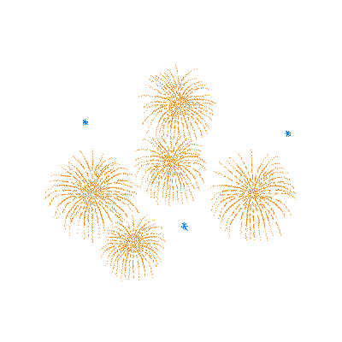

https://docs.google.com/document/d/14jIifDcZxoGgpbSa30SXVZnUpet79vkvsY_fvch-qx0/edit#
Here is the EKS NoteBook Link

Slide 30

Y
o
u
Y
o
u
r
F
r
i
e
n
d
You already saw the Network Policies Rules too,
right?
yes
Before RBAC Configuration,
I want to give you some background.

Slide 31
Create CusterRole/Role
Create ClusterRoleBinding/RoleBinding
Editing kube-config file
RBAC to control access to resources

Slide 32
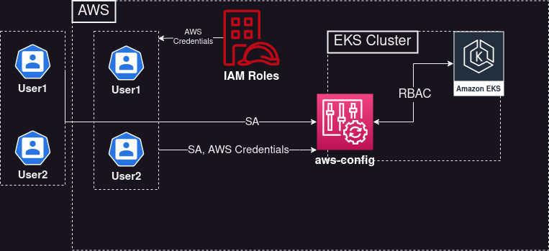
RBAC to control access to resources

Slide 33
https://docs.google.com/document/d/14jIifDcZxoGgpbSa30SXVZnUpet79vkvsY_fvch-qx0/edit#
Page 5
Lets Jump Back to RBAC

Slide 34

Y
o
u
Y
o
u
r
F
r
i
e
n
d
How are you feeling now?
Fantastic but…
But what ??? Just one more topic, okay?

Slide 35
Y
o
u
Y
o
u
r
F
r
i
e
n
d
How can we restrict deployment of a pod to a node/nodegroup?
Can we jump to the next slide ;)

Slide 36
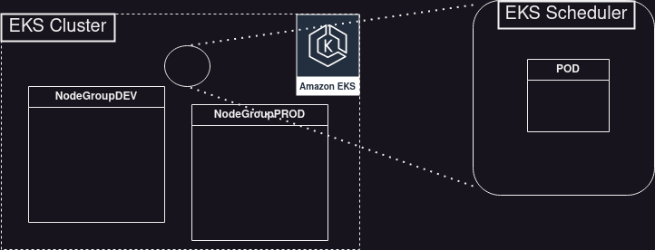
By Default
node2
node1
node2
node1

Slide 37
With Restrictions Applied
node2
nodeGroup: NodeGroupPROD
node1
node2
node1

Slide 38
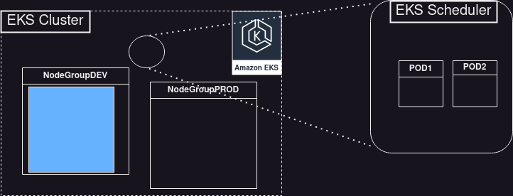
NodeAffinity
node2
nodeGroup: NodeGroupDEV
node1
node2
node1

Slide 39
NodeAnit-Affinity
node2
nodeGroup: NodeGroupPROD
node1
node2
node1

Slide 40
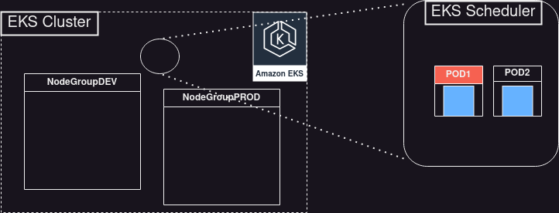
PodAffinity
node2
nodeGroup: NodeGroupPROD
node1
node2
node1

Slide 41

Y
o
u
Y
o
u
r
F
r
i
e
n
d
Now you better know, what the PodAnti-Affinity is !

Slide 42
https://docs.google.com/document/d/14jIifDcZxoGgpbSa30SXVZnUpet79vkvsY_fvch-qx0/edit#
Page 5
Lets Jump Back to NoteBook

Slide 43

Y
o
u
Y
o
u
r
F
r
i
e
n
d
This was the last topic for today, right?
Yes

Slide 44
Y
o
u
Y
o
u
r
F
r
i
e
n
d
Let’s wrap this up for today

Slide 45
How do you connect to EKS cluster?
Using AWS EKS Endpoints
public/private

Slide 46
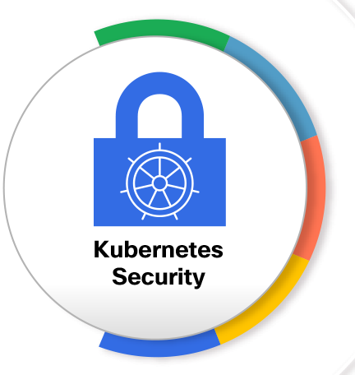
Security Considerations
Internal TLS and encryption
process of securing communications between various components within a Kubernetes cluster
Pod-level network and security rules
ability to define network and security policies at the level of individual Pods
Deployment restrictions to specific node groups
By default, Kubernetes will schedule the deployment of containers across all available nodes in a cluster

Slide 47
Security Considerations
Things to Remember
Internal TLS and encryption
Kubernetes components to use TLS?
Secure communication between Kubernetes components?
Cilium Use RBAC to control access to resources?
ClusterRole/Role, ClusterRoleBinding/RoleBinding configMap/aws-auth

Slide 48
Security Considerations
Things to Remember
Pod-level network and security rules
Network Policies with CNI Plugins Pod-pod, ingress, egress, protocol, port AWS Network Firewall

Slide 49
Security Considerations
Things to Remember
Deployment restrictions to specific node groups
nodeName simplest with limitations
Kubernetes affinity and anti-affinity rules
node/pod affinity/anti-affinity preferred & required

Slide 50
Y
o
u
Y
o
u
r
F
r
i
e
n
d
That was a great learning today. Thank you soooo much !!!
I also learn while sharing knowledge with you :)
You are most welcome my friend.

Slide 51

Y
o
u
Y
o
u
r
F
r
i
e
n
d
Any Questions ?

Slide 52

Elastic Kubernetes Service
Presented by: Bibek Mishra

Slide 53

This week I researched on it and implemented in my EKS Cluster.
Me
M
y
F
r
i
e
n
d
Yes Yes !!
Last time you were curious about customizability in EKS, right?
That’s great bro :)

Slide 54



Me
M
y
F
r
i
e
n
d
The stage is yours
I want to share my findings on Customizability to you and all the lovely people here.
Please give a round of applause

Slide 55
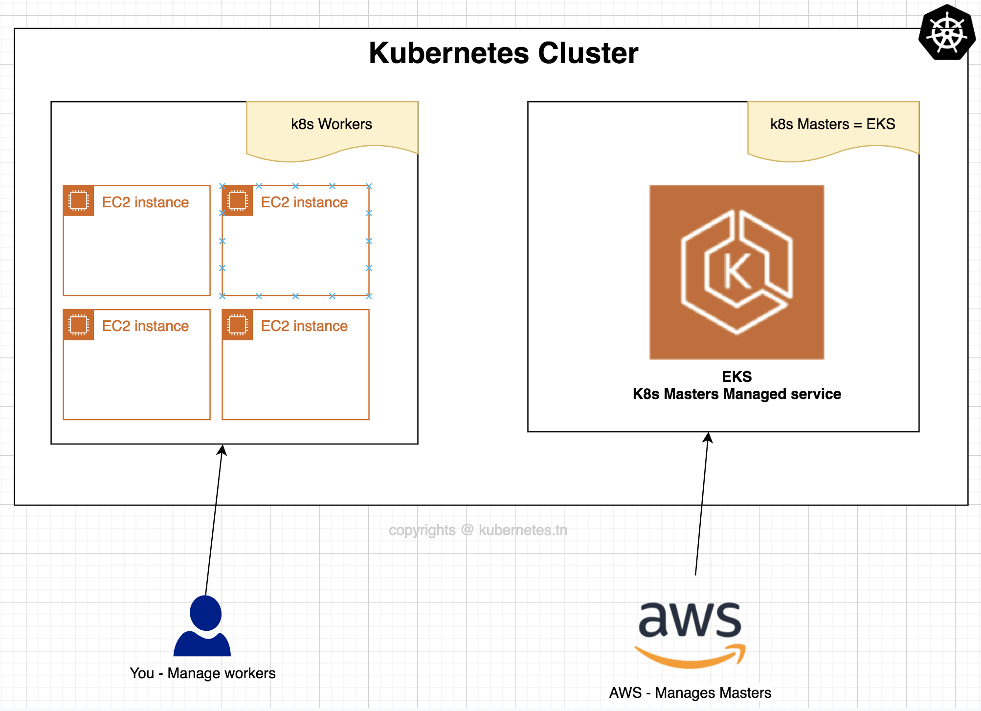

Slide 56

Master Node Customization
Worker Node Customization
Storage
Networking, etc
Customizability

Slide 57
Customizability
Version(1.26, 1.25, 1.24, etc..),
Networking(vpc,subnet,sg,etc),
Cluster log types (api, audit, authenticator, etc),
Cluster accessibility (private/public)...
Master Node Customization

Slide 58
Prod VPC
Dev VPC
Security Group Rules
Security Group Rules
Private Endpoint
Public Endpoint

Slide 59
There is limitation to customize Master in EKS, right?
Me
M
y
F
r
i
e
n
d
Yes :) Using EKS we only focus on Worker Node Customization

Slide 60
Customizability
Self managed nodes
Managed node groups
AWS Fargate
Worker Node Customization

Slide 61
Customizability
Steps
Create an EC2
Manually configure the instances to join the EKS cluster
Responsible for maintenance and upgrades
Worker Node Customization
Self managed nodes

Slide 62
Manually configure the instances to join the EKS cluster
apiVersion: v1
kind: ConfigMap
metadata:
name: aws-auth
namespace: kube-system
data:
mapRoles: |
- rolearn: <YOUR_NODE_INSTANCE_ROLE_ARN>
username: system:node:{{EC2PrivateDNSName}}
groups:
- system:bootstrappers
- system:nodes
kubectl apply -f self-managed.yaml

Slide 63

Customizability
eksctl create nodegroup \
--cluster my-cluster \
--region region-code \
--name my-mng \
--node-ami-family ami-family \
--node-type m5.large \
--nodes 3 \
--nodes-min 2 \
--nodes-max 4 \
--ssh-access \
--managed=true \
--ssh-public-key my-key
Worker Node Customization
Managed Node Groups

Slide 64
Customizability
EKS manages
Upgrades
Maintenance
Automatically registers and deregisters
Focus more on your application workloads
Worker Node Customization
Managed Node Groups

Slide 65
I will prefer managed node groups to self managed
Me
M
y
F
r
i
e
n
d
If you require fine-grained control over your worker nodes, use self managed

Slide 66
You can also use multiple node groups based on your requirements :)
Me
M
y
F
r
i
e
n
d
Multiple-Node Groups ??????

Slide 67
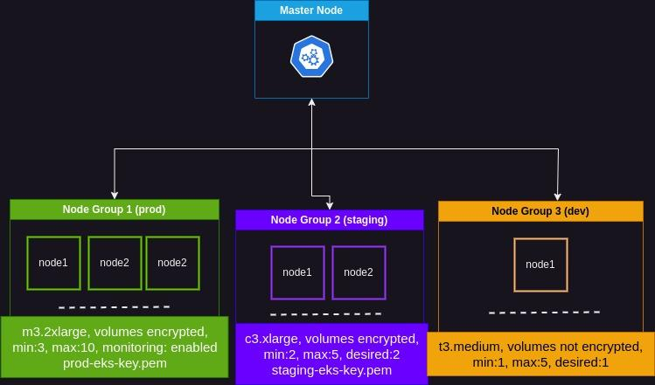
Multi-NodeGroup

Slide 68

Have you created different launch templates for different nodeGroups ?
Me
M
y
F
r
i
e
n
d
Yes/No my friend

Slide 69
Different ways to create NodeGroups
Me
M
y
F
r
i
e
n
d
launch template eksctl
Self-managed nodeGroups.

Slide 70
Sample of Launch template
resource "aws_launch_template" "eks_node_group_launch_template" {
name_prefix = "${var.name}-eks-${var.stage}-node"
monitoring {
enabled = true
}
ebs_optimized = true
key_name = aws_key_pair.eks_key_pair.key_name
block_device_mappings {
device_name = "/dev/xvda"
ebs {
encrypted = true
kms_key_id = aws_kms_key.eks_kms_key.arn
volume_size = 50
volume_type = "gp3"
iops = 3500
throughput = 350
delete_on_termination = true
}
}

Slide 71
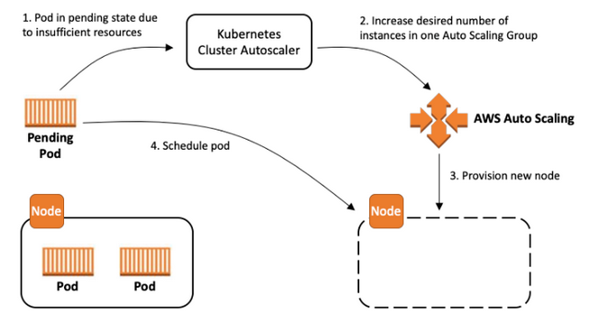
With Min, Max values, EKS automatically scale up/down the number of nodes?
EKS
Me
M
y
F
r
i
e
n
d
Min: 1, desired: 1, max: 2
????????
No !!

Slide 72
We Use Separate components: clusterAuto-scaler, Vertical Node Scaling, etc
Me
M
y
F
r
i
e
n
d

Slide 73
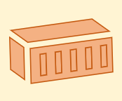
Node Scalability
Cluster Autoscaler

Slide 74
What about pods?
Can we scale up/down the pods too as Node?
Me
M
y
F
r
i
e
n
d
Yes, with other components like: HPA, VPA

Slide 75
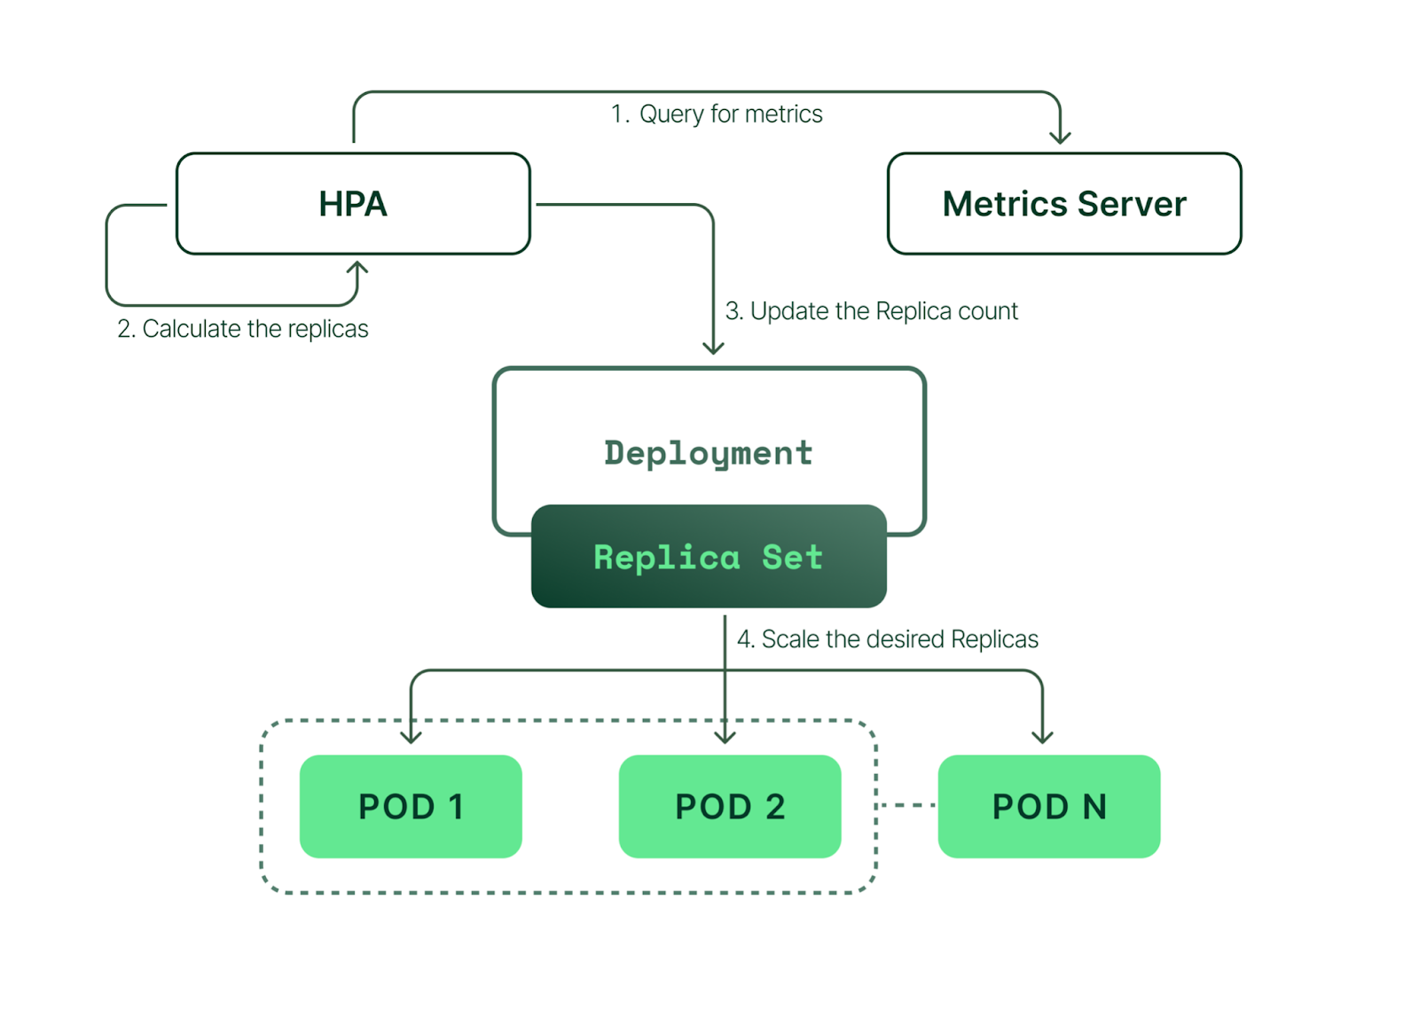
Pod Scalability
Horizontal Pod Autoscaler

Slide 76


It will be better if we can see this happening live, Like giving a demo.
Me
M
y
F
r
i
e
n
d
Sorry, we do not have enough time

Slide 77

Okay Okay
Me
M
y
F
r
i
e
n
d
Just a small demo on HPA.
Happy?

Slide 78
Customizability
Things to Remember
Customizability
Master Customization version(1.26, 1.25, 1.24, etc..), networking(vpc,subnet,sg,etc), cluster log types(api, audit, authenticator, etc), cluster accessibility(private/public)
Master Node Customization
Worker Node Customization
Worker Node Customization Self managed nodes Managed node groups AWS Fargate

Slide 79
Can we create self-managed node groups with EKSCTL command?
“Two nodeGroups are with same specs(e.g. instance type, storage…)” Does above sentence satisfies the multi-nodeGroup support ?
True/False
True
True/False
True

Slide 80
Scalability
Things to Remember
Scalable pod and node management
Pod Scalability
Node Scalability
HPA, VPA
Cluster AutoScaler, Vertical Node Scaling

Slide 81

Agenda
Build a properly documented EKS cluster. With the following consideration as key. - Security (internal TLS, all things encrypted, pod level network & security rules, ...) - Customizable/Modular
- Support for AWS and Custom launch template - Multi-nodegroup support
- Pod Deployment restriction to the specific node group
- Scalable Pod and Nodes.
- Full logging, monitoring, and alerting system. - ELK Implementation for easy view of all logs in EKS (cluster, application, etc...)
Security Considerations
Customizability
Scalability
Logging, Monitoring and Alerting

Slide 82
Elasticsearch
stores and indexes log data
FluentD
collects and forwards log data to Elasticsearch
Kibana
provides a visual interface to explore and analyze the log data stored in Elasticsearch
4. EFK

Slide 83
Prometheus collects metrics from various targets,
Grafana provides visualizations and analytics for the collected data
Node Exporter collects host-level metrics
Alertmanager handles alert notifications
Together, they form a monitoring and visualization stack that helps you monitor the health and performance of your Kubernetes cluster and applications, and take necessary actions based on alerts and insights.
5. Prometheus & Grafana

Slide 84
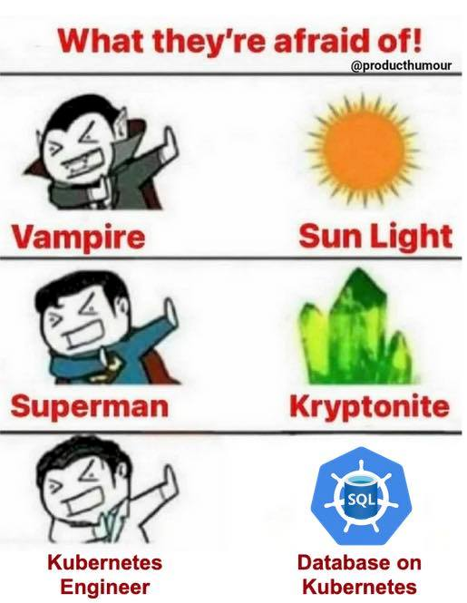

Slide 85

EKS Elastic Kubernetes Service
Presented by: Bibek Mishra

Slide 86

How do you compare AWS EKS to other container orchestration platforms ?

